Slide 1
Chapter 2: Functions and classes

Slide 2
Chapter 2: Functions and classes
2.3. File and Execptions
Reading from a File
Writing to a File
Exception
Storing Data

Slide 3
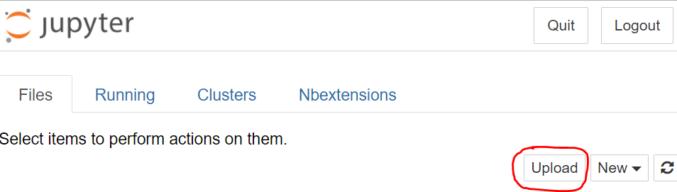

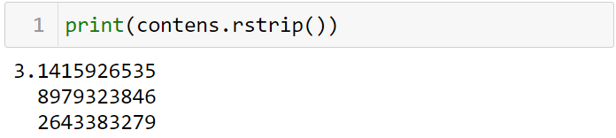
Reading from a File
Reading an Entire File
Upload file: pi_digits.txt
returns an object representing pi_digits.txt
The keyword with closes the file once access to it is no longer needed
we use the read() method to read the entire contents of the file and store it as one long string in contents

Slide 4
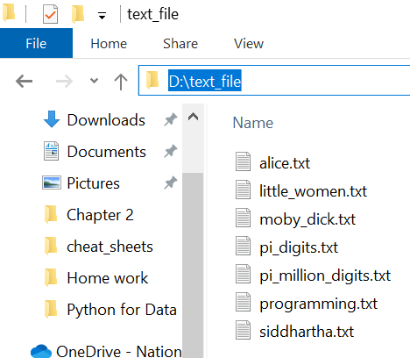
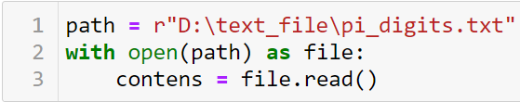
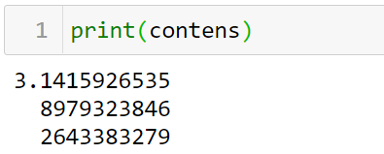
Reading from a File
File Paths
Note Windows systems use a backslash (\) instead of a forward slash (/) when displaying file paths, but you can still use forward slashes in your code.

Slide 5
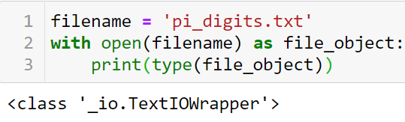
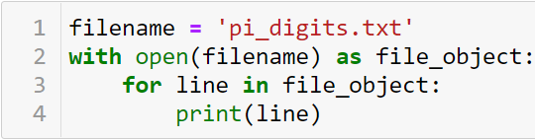
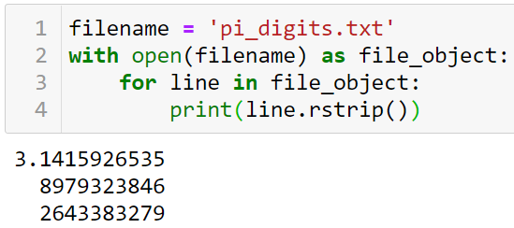
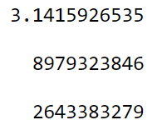
Reading from a File
Reading Line by Line

Slide 6
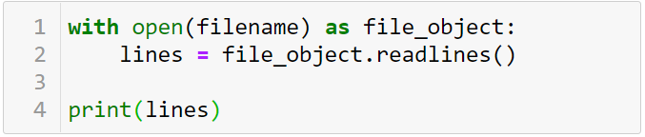
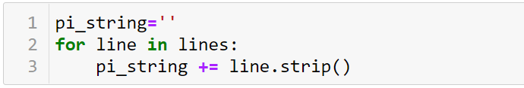
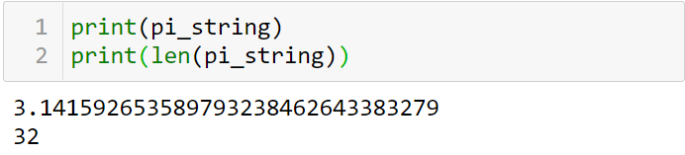
Reading from a File
Making a List of Lines from a File
Working with a File’s Contents

Slide 7
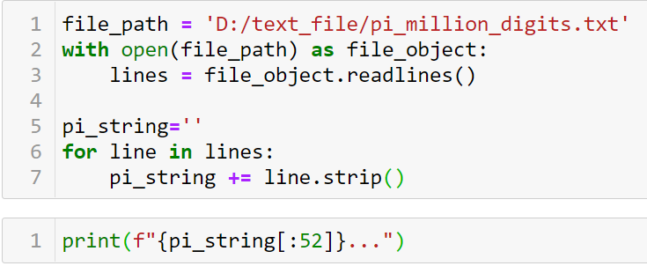

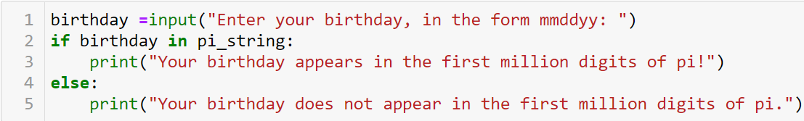
Reading from a File
Large Files: One Million Digits
Is Your Birthday Contained in Pi?

Slide 8
Practice
10-1,10-2

Slide 9
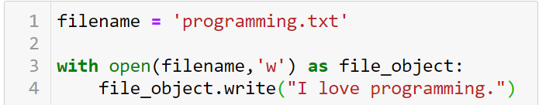
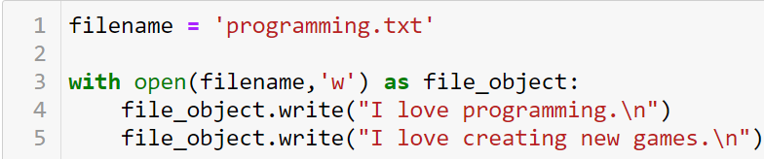
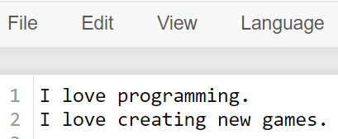
Writing to a File
write mode (‘w’)
append mode ('a’)
read mode ('r')
Reading an Entire File
Note: Python can only write strings to a text file. If you want to store numerical data in a text file, you’ll have to convert the data to string format first using the str() function
the write() method on the file object to write a string to the file
Writing Multiple Lines

Slide 10
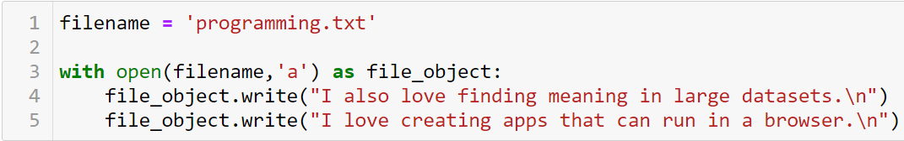
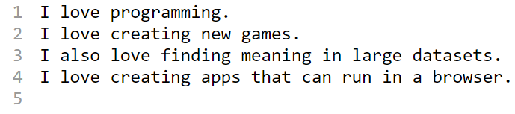
Writing to a File
Appending to a File

Slide 11
Practice
10-3,…,10-5

Slide 12
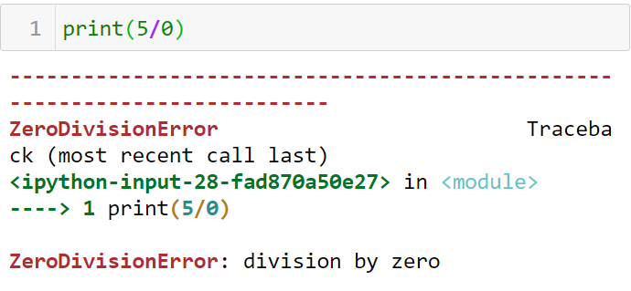
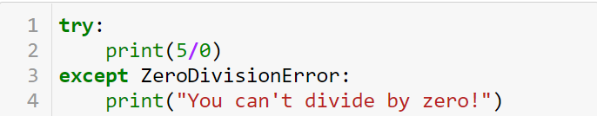

Exceptions
Handling the ZeroDivisionError Exception
Using try-except Blocks

Slide 13
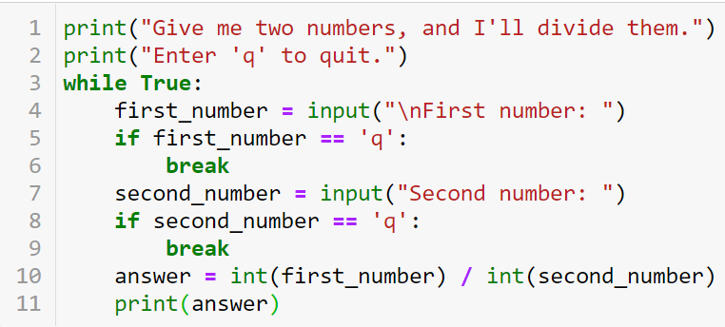
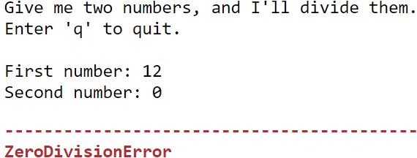
Reading from a File
The else Block

Slide 14
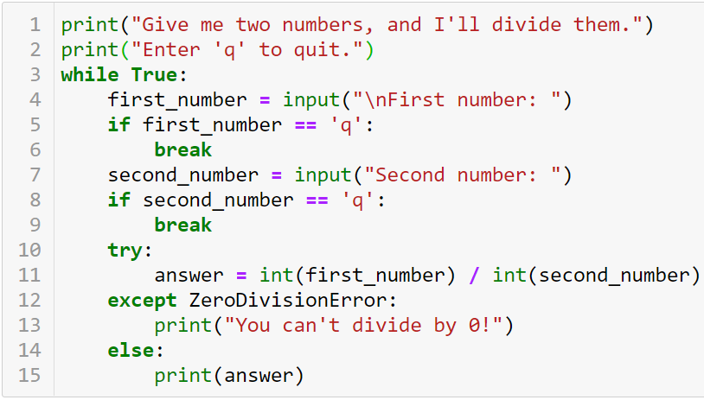
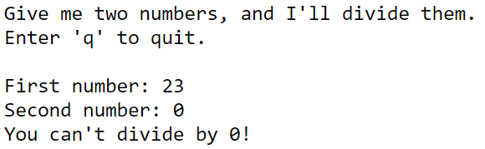
Reading from a File

Slide 15
Counting…
Count the frequency of each word in
filenames = ['alice.txt', 'siddhartha.txt', 'moby_dick.txt', 'little_women.txt']

Slide 16
Practice
10-6,…, 10-10

Slide 17

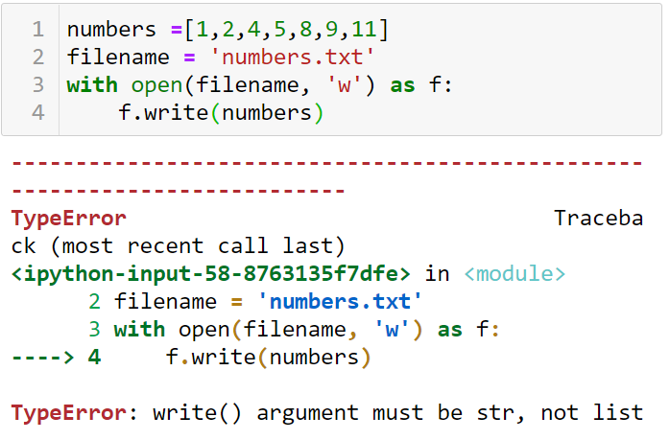
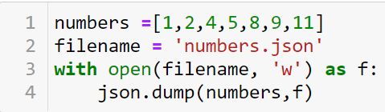
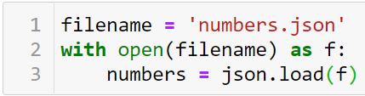
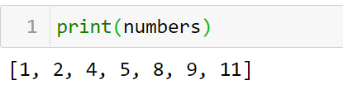
Storing Data
Using json.dump() and json.load()
The JSON (JavaScript Object Notation)

